Slide 1
C Functions

Slide 2
Objectives
To understand how to construct programs modularly from small pieces called functions.
To introduce the common math functions available in the C standard library.
To be able to create new functions.
To understand the mechanisms used to pass information between functions.
To understand how to write and use functions that call themselves.

Slide 3
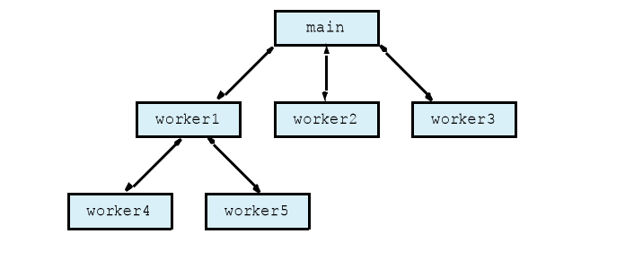
Function call analogy:
Boss asks worker to complete task
–Worker gets information, does task, returns result
–Information hiding: boss does not know details

Slide 4
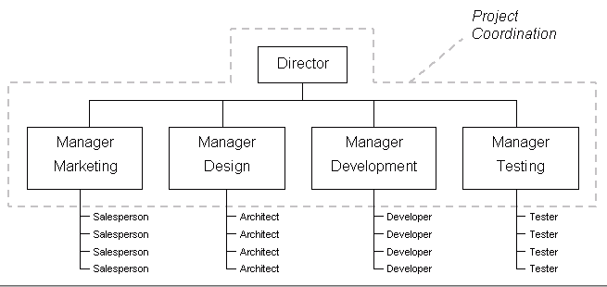
Advantages and disadvantages of function.

Slide 5

Advantages contd.

Slide 6
Function
In programming, a function is a segment that groups code to perform a specific task.
A C program has at least one function main( ).
Without main() function, there is technically no C program.
Types of C functions:
There are two types of functions in C programming:
Pre defined function
User defined function

Slide 7
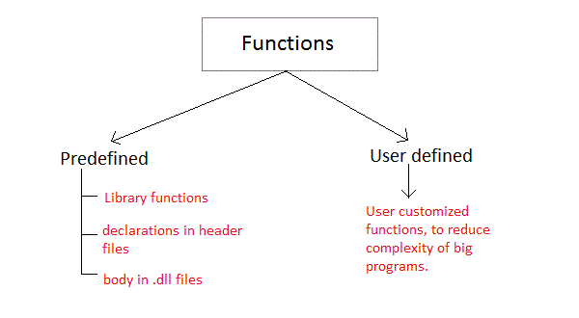
Types of function

Slide 8
Pre defined function
main()
The execution of every C program starts from this main() function.
Library functions are the in-built function in C programming system.
For example:
printf()
prinf() is used for displaying output in C.
scanf()
scanf() is used for taking input in C.

Slide 9
User defined function
C allows programmer to define their own function according to their requirement.
These types of functions are known as user-defined functions.
Suppose, a programmer wants to find factorial of a number and check whether it is prime or not in same program.
Then, he/she can create two separate user-defined functions in that program:
one for finding factorial
and other for checking whether it is prime or not.

Slide 10
How user-defined function works in C Programming?
#include <stdio.h>
void function_name(){
................
................
}
int main(){
...........
...........
function_name();
...........
...........
}

Slide 11
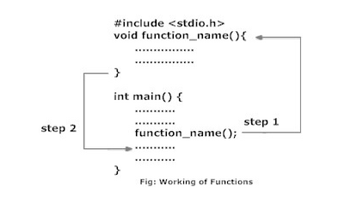

Slide 12
Explanation:
As mentioned earlier, every C program begins from main() and program starts executing the codes inside main() function.
When the control of program reaches to function_name() inside main() function.
The control of program jumps to void function_name() and executes the codes inside it.
When all the codes inside that user-defined function are executed, control of the program jumps to the statement just after function_name() from where it is called.
Remember, the function name is an identifier and should be unique.

Slide 13
Let’s Recap
Function’s are the building blocks of c.
A c program must contain at least one function i.e. main().
However most c program contains more than one function.
The general form of function name is
return_type function_name ( parameter_list )
{
// body of the function
}

Slide 14
The general form of a c program that has multiple functions is shown here :
/* include header files here */
/* function prototypes here */
int main( void )
{
/* */
}
ret_type f1( param_list )
{
/* */
}
ret_type f2( param_list )
{
/* */
}
……………………………………………………
ret_type fN( param_list )
{
/* */
}

Slide 15
Here return_type refers to data returned by the function . If a function does not return a value then its return type should be void.
If a function does not use parameters, then its param_list should contain the keyword void.
A function prototype declares a function before it is used and prior to its definition.
A prototype consists of a function name, its return type and its parameter list and it is terminated by a semicolon.

Slide 16
Advantages of user defined functions
User defined functions helps to decompose the large program into small segments which makes programmer easy to understand, maintain and debug.
If repeated code occurs in a program. Function can be used to include those codes and execute when needed by calling that function.
Programmer working on large project can divide the workload by making different functions.

Slide 17
Example of user-defined function
The following program contains two functions : main() and func1()
#include <stdio.h>
void func1( void);
int main (void)
{
printf(“I ”);
func1();
printf( “C .”);
return 0;
}
Void func1()
{
printf(“ like ”);
}

Slide 18
Lets Recap:
A function is a group of statements that together perform a task.
Every C program has at least one function, which is main(),
And all the most trivial programs can define additional functions.
You can divide up your code into separate functions.
How you divide up your code among different functions is up to you,
But logically the division usually is so each function performs a specific task.
A function declaration tells the compiler about a function's name, return type, and parameters.
A function definition provides the actual body of the function.

Slide 19
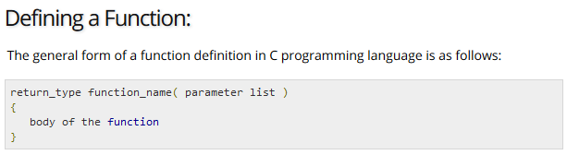
The C standard library provides numerous built-in functions that your program can call.
For example, function strcat() to concatenate two strings,
function memcpy() to copy one memory location to another location and many more functions.
A function is known with various names like a method or a sub-routine or a procedure, etc.

Slide 20
A function definition in C programming language consists of a function header and a function body. Here are all the parts of a function:
Return Type: A function may return a value. The return_type is the data type of the value the function returns. Some functions perform the desired operations without returning a value. In this case, the return_type is the keyword void.
Function Name: This is the actual name of the function. The function name and the parameter list together constitute the function signature.
Parameters: A parameter is like a placeholder. When a function is invoked, you pass a value to the parameter. This value is referred to as actual parameter or argument. The parameter list refers to the type, order, and number of the parameters of a function. Parameters are optional; that is, a function may contain no parameters.
Function Body: The function body contains a collection of statements that define what the function does.

Slide 21
#include<stdio.h>
int function();
int main()
{
int i;
function();
printf(“%d”,i);
return 0;
}
int function()
{
int a;
a=5;
return a;
}
5
call

Slide 22
For better understanding of Parameters and return type in functions, user-defined functions can be categorized as:
Function with no arguments and no return value.
Function with no arguments and return value.
Function with arguments but no return value.
Function with arguments and return value.
Let's take an example to find whether a number is prime or not using above 4 categories of user defined functions.

Slide 23
#include <stdio.h>
void prime();
int main(){
prime();
return 0;
}
void prime(){
int num,i,flag=0;
printf("Enter positive integer enter to check:\n");
scanf("%d",&num);
for(i=2 ; I < = num/2; i++){
if(num%i==0){
flag=1;
}
}
if (flag==1)
printf("%d is not prime",num);
else
printf("%d is prime",num);
}
call
return

Slide 24
#include <stdio.h>
int prime();
int main(){
int flag;
flag=prime();
if(flag == 1) printf("not prime");
else printf("prime");
}
int prime(){
int num,i,flag = 0;
printf("Enter positive integer to check:\n");
scanf("%d",&num);
for(i=2; i<=num/2; ++i){
if(num%i==0){
flag = 1;
break;
}
}
return flag;
}
call
Flag (0/1)

Slide 25
Types of Variables:
A variable is just a named area of storage that can hold a single value (numeric or character).
The C language demands that you declare the name of each variable that you are going to use and its type, or class, before you actually try to do anything with it.
The Programming language C has two main variable types
Local Variables
Global Variables

Slide 26
Local Variables
Local variables scope is confined within the block or function where it is defined.
Local variables must always be defined at the top of a block.
When a local variable is defined - it is not initialized by the system, you must initialize it yourself.
When execution of the block starts the variable is available, and when the block ends the variable 'dies'.

Slide 27
main()
{
int i=4;
int j=10;
i++;
if (j > 0)
{
/* i defined in 'main' can be seen */
printf("i is %d\n",i);
}
if (j > 0)
{
/* 'i' is defined and so local to this block */
int i=100;
printf("i is %d\n",i);
}/* 'i' (value 100) dies here */
printf("i is %d\n",i); /* 'i' (value 5) is now visable.*/
}
This will generate following output
i is 5
i is 100
i is 5

Slide 28
Global Variables
Global variable is defined at the top of the program file and it can be visible and modified by any function that may reference it.
Global variables are initialized automatically by the system when you define them
If same variable name is being used for global and local variable then local variable takes preference in its scope.
But it is not a good practice to use global variables and local variables with the same name.

Slide 29
int i=4; /* Global definition */
main() {
i++; /* Global variable */
func();
printf( "Value of i = %d -- main function\n", i );
}
func()
{
int i=10; /* Local definition */
i++; /* Local variable */
printf( "Value of i = %d -- func() function\n", i );
}
This will produce following result
Value of i = 11 -- func() function
Value of i = 5 -- main function

Slide 30
Local Variables Recap:
The scope of local variables will be within the function only.
These variables are declared within the function and can’t be accessed outside the function.
In the below example, m and n variables are having scope within the main function only. These are not visible to test function.
Like wise, a and b variables are having scope within the test function only. These are not visible to main function.

Slide 31
#include<stdio.h>
void test();
int main()
{
int m = 22, n = 44;
// m, n are local variables of main function
/*m and n variables are having scope
within this main function only.
These are not visible to test funtion.*/
/* If you try to access a and b in this function,
you will get ‘a’ undeclared and ‘b’ undeclared error */
printf(“\nvalues : m = %d and n = %d”, m, n);
test();
}
void test()
{
int a = 50, b = 80;
// a, b are local variables of test function
/*a and b variables are having scope
within this test function only.
These are not visible to main function.*/
/* If you try to access m and n in this function,
you will get ‘m’ undeclared and ‘n’ undeclared
error */
printf(“\nvalues : a = %d and b = %d”, a, b);
}

Slide 32
Global Variable Recap
The scope of global variables will be throughout the program.
These variables can be accessed from anywhere in the program.
This variable is defined outside the main function.
So that, this variable is visible to main function and all other sub functions.

Slide 33
#include<stdio.h>
void test();
int m = 22, n = 44;
int a = 50, b = 80;
int main()
{
printf(“All variables are accessed from main function”);
printf(“\nvalues: m=%d:n=%d:a=%d:b=%d”, m,n,a,b);
test();
}
void test()
{
printf(“\n\nAll variables are accessed from” \
” test function”);
printf(“\nvalues: m=%d:n=%d:a=%d:b=%d”, m,n,a,b);
}

Slide 34
#include<stdio.h>
int Add();
// Global variables
int A;
int B;
int main()
{
int answer; // Local variable
A = 5;
B = 7;
answer = Add();
printf("%d\n",answer);
return 0;
}
int Add()
{
return A + B;
}

Slide 35
Arguments But no Return Value
5
function()
{
function2( 5 );
………………..
}
function2 ( int a )
{
printf(“ %d”,a);
………………….
………………….
}

Slide 36
Let us consider a code
#include<stdio.h>
void sum( int x, int y);
int main()
{
sum(1,20);
sum(9,61);
sum(81,9);
return 0;
}
void sum( int x, int y)
{
printf(“%d ”,x+y);
}
1,20
9,61
81,9
X=1, y=20
X=9, y=61
X=81 , y=9

Slide 37
#include<stdio.h>
void outchar( char ch);
int main()
{
outchar(‘A’);
outchar(‘b’);
outchar(‘C’);
return 0;
}
void outchar( char ch)
{
printf(“%c\n”,ch);
}
A
b
C
ch=‘A’
ch=‘b’
ch=‘C’

Slide 38
#include<stdio.h>
void square_it ( int num);
int main()
{
square_it (10);
square_it (15);
square_it (5);
return 0;
}
void square_it ( int num)
{
printf(“%d”, num*num);
}
10
15
5
num=10
num=15
num= 5

Slide 39
Example:
Following is the source code for a function called max(). This function takes two parameters num1 and num2 and returns the maximum between the two:
int max(int num1, int num2)
{
/* local variable declaration */
int result;
if (num1 > num2)
result = num1;
else
result = num2;
return result;
}

